Slide 1
Digital Image Processing 图像信息处理
宋明黎
brooksong@zju.edu.cn
计算机学院
浙江大学
2023秋冬学期
Mingli Song
College of Computer Science, Zhejiang University
brooksong@zju.edu.cn
http://person.zju.edu.cn/msong/

Slide 2
Transformation between color spaces
RGB<->CMY
RGB<->HSV
RGB<->CIE XYZ
CIE XYZ<->CIE L*a*b*
RGB<->CIE YUV

Slide 3
RGB<->CMY
RGB->CMY
C = 255 – R
M = 255 – G
Y = 255 – B

Slide 4
RGB<->HSV
Search in table
CIE has defined transformation tables
RGB<->XYZ
HSV<->XYZ
Hence, you can
RGB->XYZ, XYZ->HSV
HSV->XYZ, XYZ->RGB

Slide 5
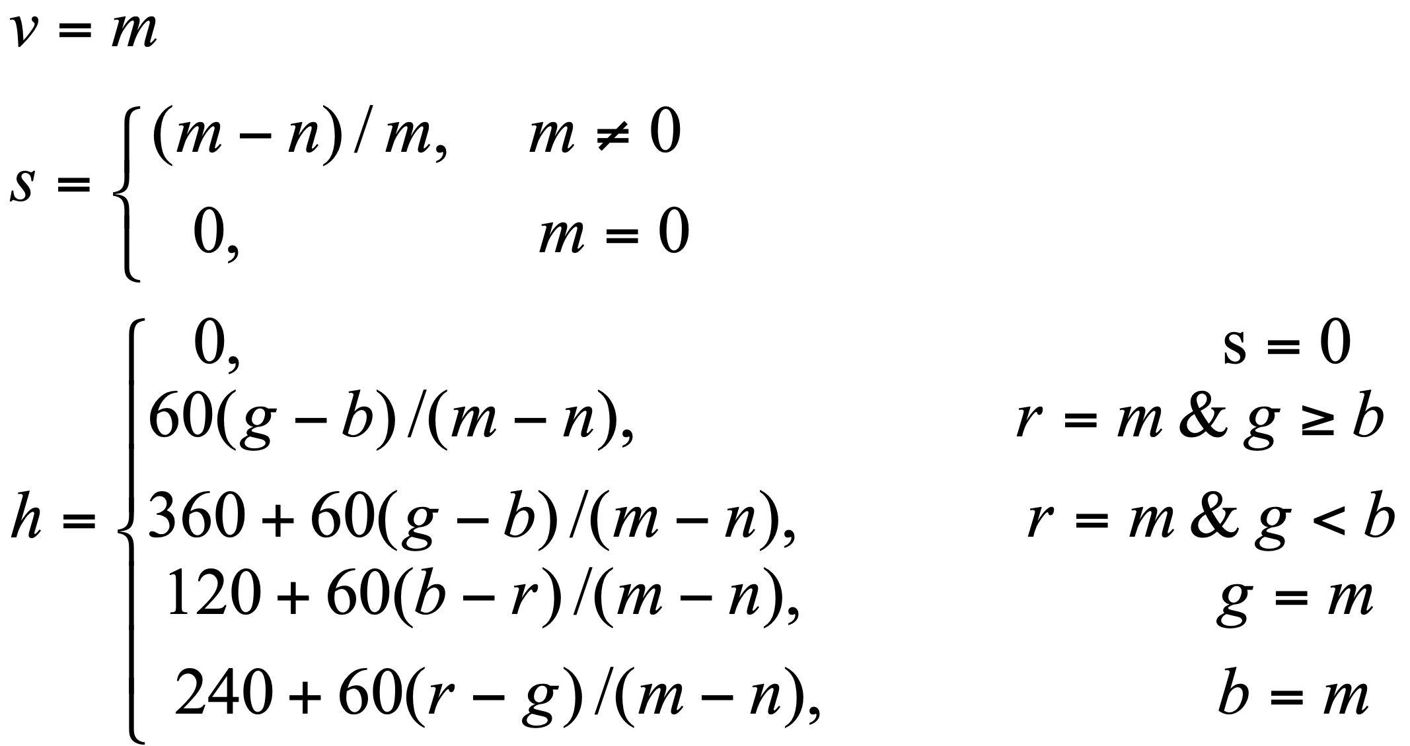
RGB<->HSV
Compute directly
From RGB to HSV
Assume m=max(r, g, b)，n=min(r, g, b), where r, g, b are normalized.

Slide 6
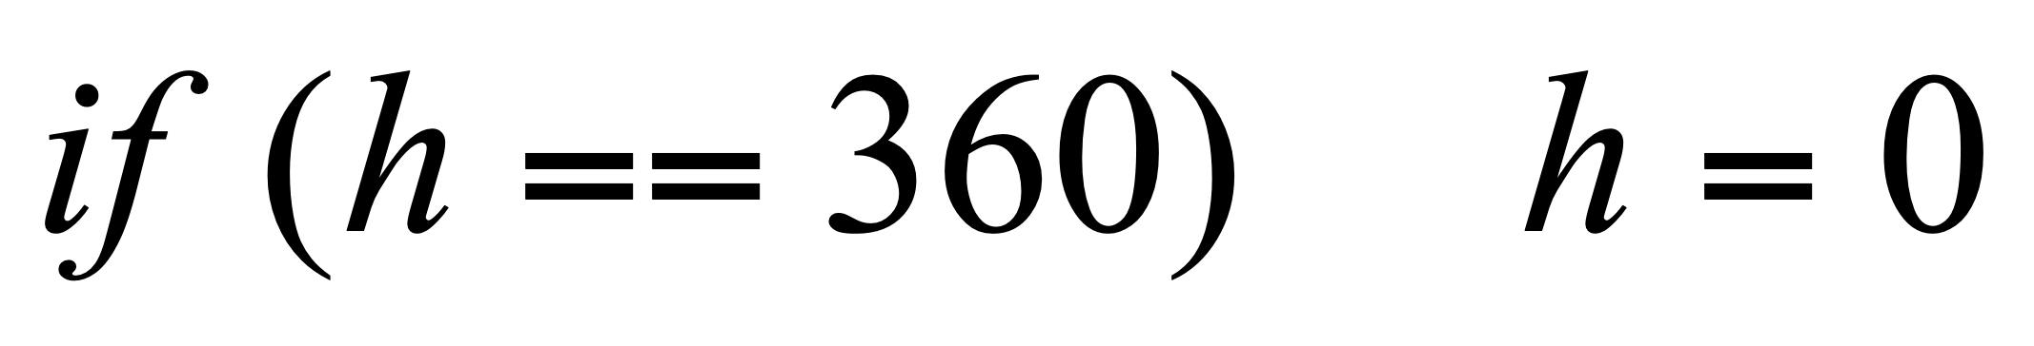
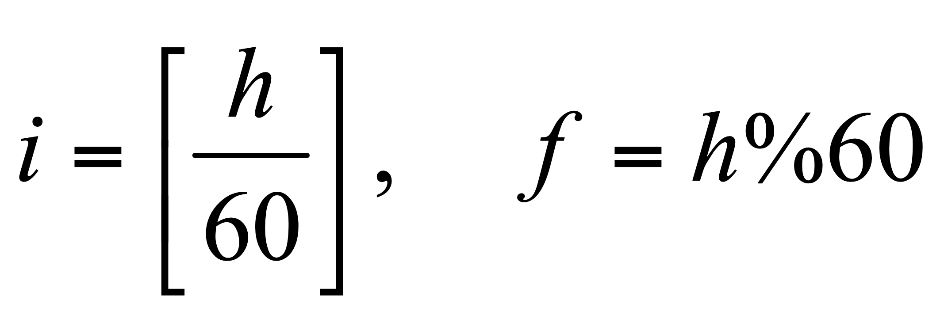
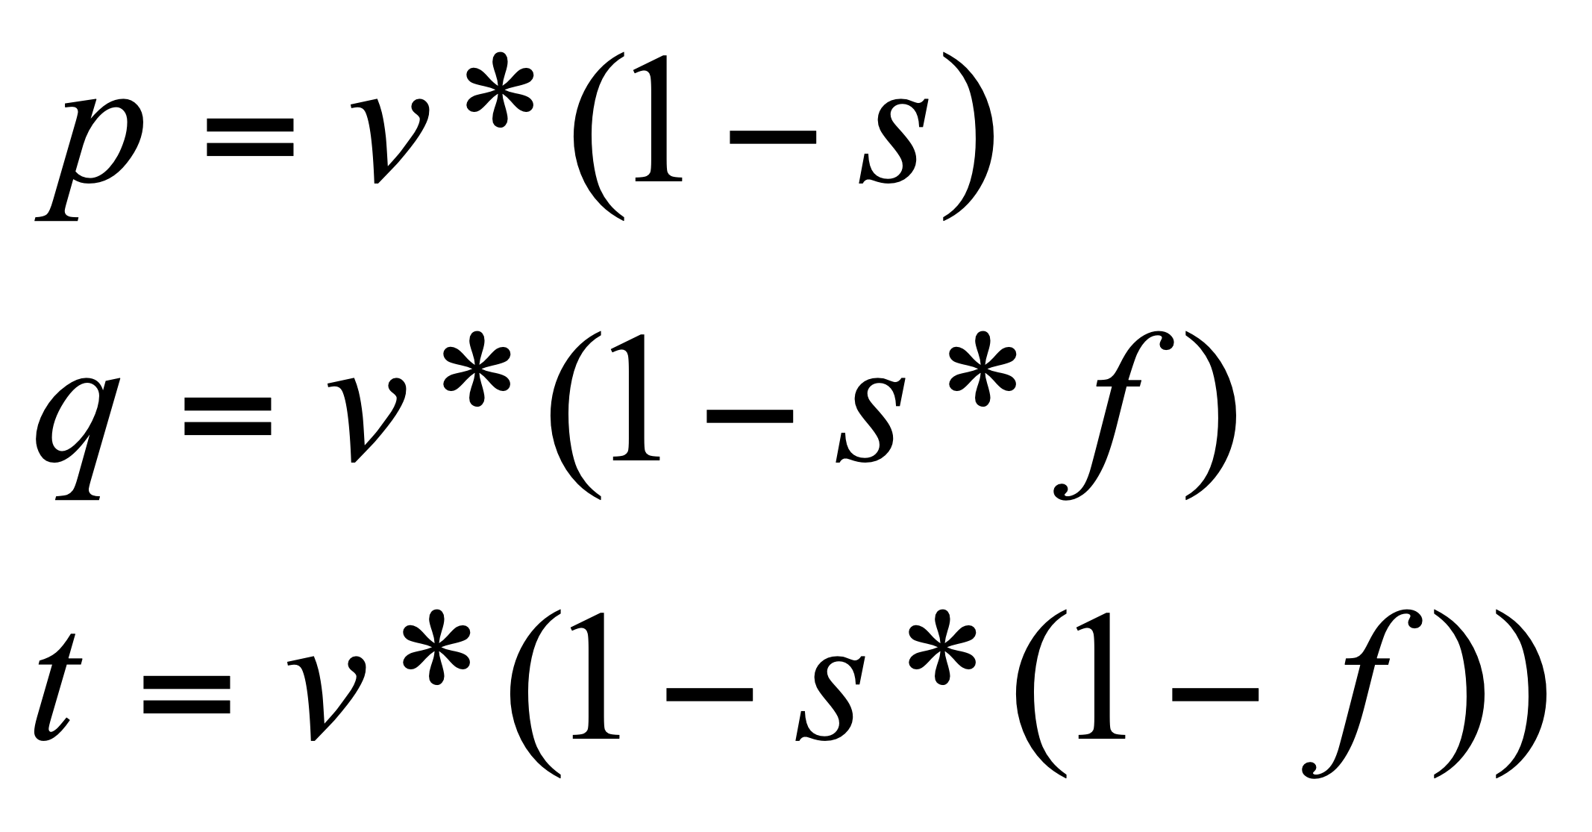
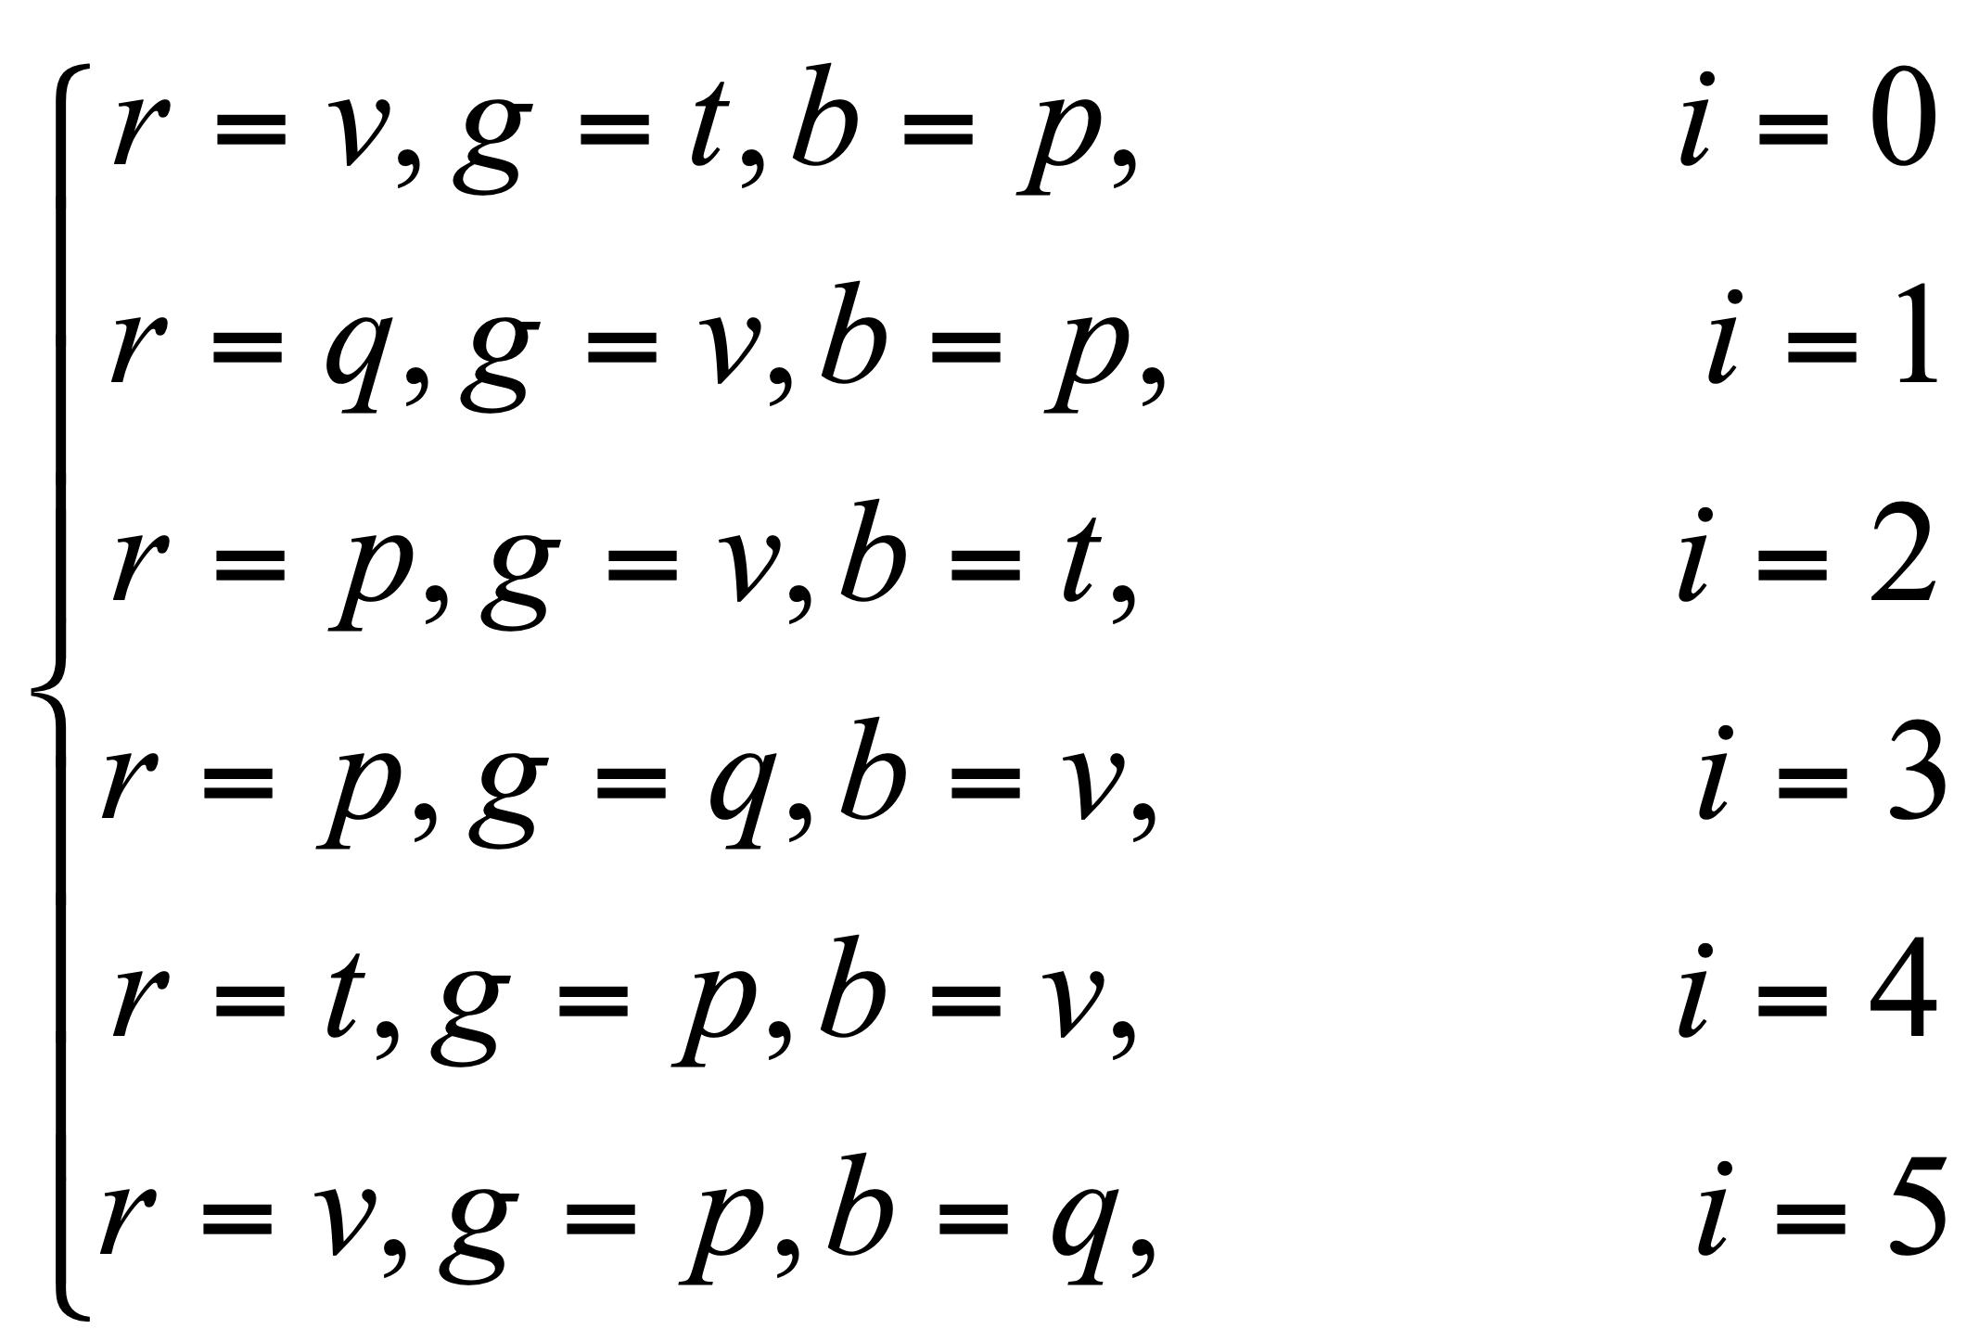
RGB<->HSV
From HSV to RGB

Slide 7
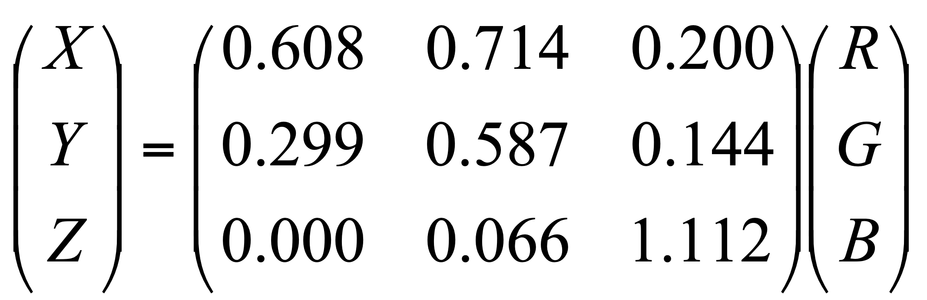
RGB<->CIE XYZ in a computable way

Slide 8
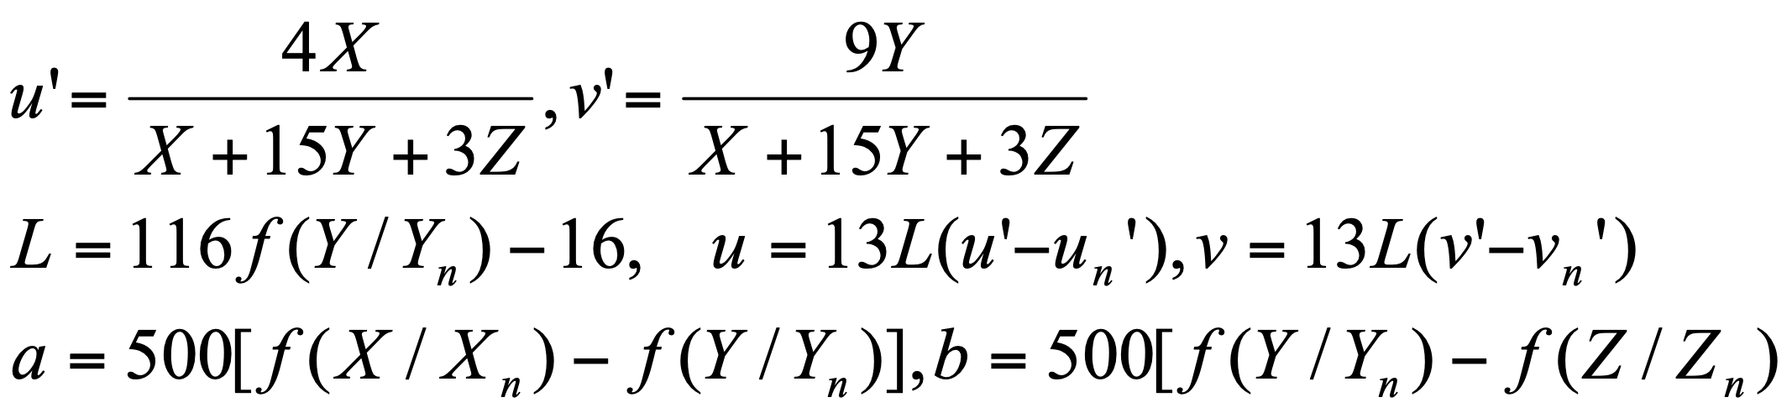
CIE XYZ<->CIE L*a*b*
L:(0,100)
a, b: (-300, 300) -a to +a: green to red
-b to +b: blue to yellow

Slide 9
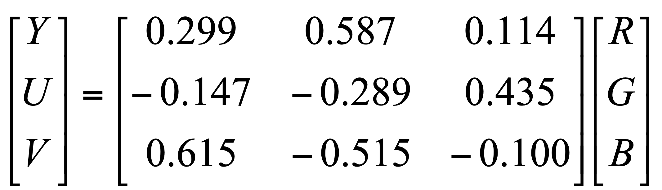
RGB<->CIE YUV

Slide 10

JPEG format
Joint Photographic Experts Group, JPEG
Founded in 1986, presented JPEG in 1992, accepted by ISO in 1994.
File extension: .JPEG, .JFIF, .JPG, .JPE
Compression format for static image
As a counterpart of Moving Picture Expert Group.
Lossy encoding method
Allow user to make balance between image quality and image size.
Encoding based on transformation, e.g. Discrete Cosine Transformation (DCT)
JPEG2000 is based on wavelet.
Different manipulations for high-frequency signal and low-frequency signal.
High freq
Low freq.
Notes:
最后一条：
对图像高频区域和低频区域区别对待。想想计算机体系结构中的哈弗曼编码，低频部分放在树的顶端，高频部分放在树的低端

Slide 11

Compression strategy: According to the requirement of compression ratio, remove information from high frequency to low frequency.
Advantages
High frequency information occupies much more memory. Hence, high frequency removal leads to high compression ratio;
Low frequency information preserves the principle structure and color distribution of object, which is the key factors of an image.
Suitable for internet based visual media.
From Left to Right: Compression ratio increases.
Notes:
压缩策略：根据压缩比要求，从高频到低频逐步削减信息
好处
高频信息占用存储空间大，减少高频信息更容易获得高压缩比；
低频信息可以保留物体的基本轮廓和色彩分布，最大限度维持图像质量。
适合用于互联网

Slide 12
JPEG syntax
JPEG file is composed by a series of segments, where each segment begins with a Marker.
Purpose of Marker: identify the image data and relative information.
Marker specification: Each Marker is composed by 2 bytes, where the first byte is constantly oxFF.
SOI | 0xD8 | Beginning of image
APP0 | 0xE0 | JFIF application data block
APPn | 0xE1-0xEF | Other application data block
DQT | 0xDB | Quantization table
SOF0 | 0xC0 | Beginning of frame
DHT | 0xC4 | Huffman table
SOS | 0xDA | Beginning of scan
EOI | 0xD9 | End of image
Notes:
JPEG文件是由一系列的segment组成的，每个segment从一个标记（Marker）开始。
标记目的：用以区分和识别图像数据及其相关信息
标记规范：每个标记都是由2个字节组成，其前一个字节是固定值0xFF

Slide 13
JPEG file organization (1)
SOI(Start of Image) Marker
APP0 Marker
APP0 Marker:
Length
Identifier
Version
Density unit of X and Y:
units=0-> no unit
units=1: points/inch
units=2: points/cm
X density
Y density
Number of thumbnail horizontal pixels
Number of thumbnail vertical pixels
Thumbnail RGB bitmap

Slide 14
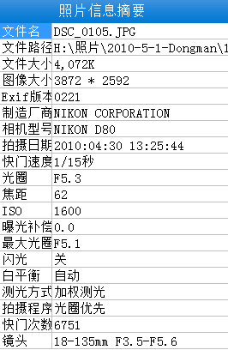
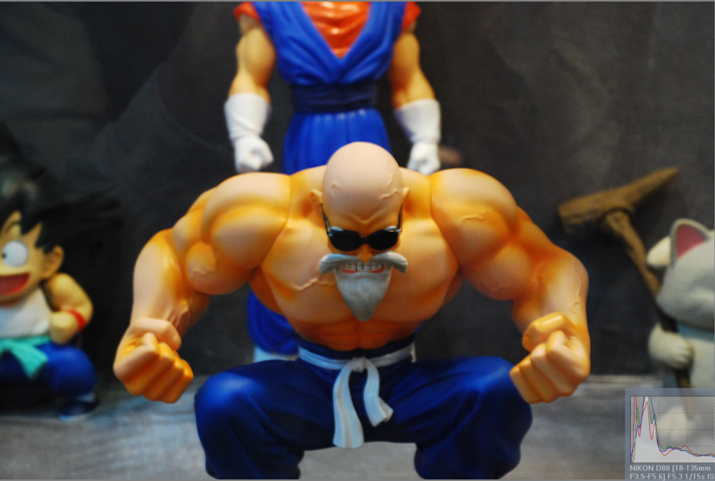
JPEG file organization (2)
(3) APPn (Markers)，n=1~15(optional)
APPn Length
Detail information: e.g., EXIF use APP1 to store meta data.
EXIF=Exchangeable image file format

Slide 15
JPEG file organization(3)
(4) One or more DQT（Define Quantization Table）
Three parts：
Quantization table length
Quantization table number
Quantization table
For a large region, human eyes can identify the subtle changes of color (low frequency region), but are very fair for the high frequency region.
Inspired by this concept, we can quantize the high frequency part to make quantization. In other words, each component on the spectrum can be divided by a constant and rounded to be zero. And different constants are required by different components. So finally we get the Quantization Table.
Notes:
人眼对于一个相对较大范围的区域，辨别色彩细微差异能力比较强（低频），但对于高频区域，却表现一般。受此启发，人们可以对高频部分进行量化，也就是说，把频域上的每个分量，除以针对该分量的常数，然后四舍五入取整，这样一般会把高频分量变为0。但这样操作就要求针对每一个分量设置一个常数值，所以就最终形成了量化表。

Slide 16
JPEG file organization (3)
(5) SOF0 (Start of Frame, DCT based)
Start of frame length
Precision: color depth (bit-width) of each color channel
Image height
Image width
Number of color components
For each color component
ID
vertical sample factor
horizontal sample factor
Quantization table #
Notes:
帧图像开始

Slide 17
JPEG file organization(4)
(6) DHT(Define Huffman Table)
Huffman table length
Type, AC or DC
Index
bits table
value table
DCT based compression
Notes:
一个或多个Huffmann表
霍夫曼表的长度(Huffman table length)
类型、AC或者DC(Type, AC or DC)
索引(Index)
位表(bits table)
值表(value table)

Slide 18
JPEG file organization (5)
(7) Start of Scan (SoS)
SoS length
Number of color components
For each color component
ID
AC table #
DC table #
Compress image data
(8) End of Image (EOI)
Notes:
(7) 扫描开始SOS(Start of Scan)
扫描开始长度(start of scan length)
颜色分量数(number of color components)
每个颜色分量
ID
交流系数表号 (AC table #)
直流系数表号 (DC table #)
压缩图像数据 (Compress image data)
(8) 图像结束EOI(End of Image)

Slide 19
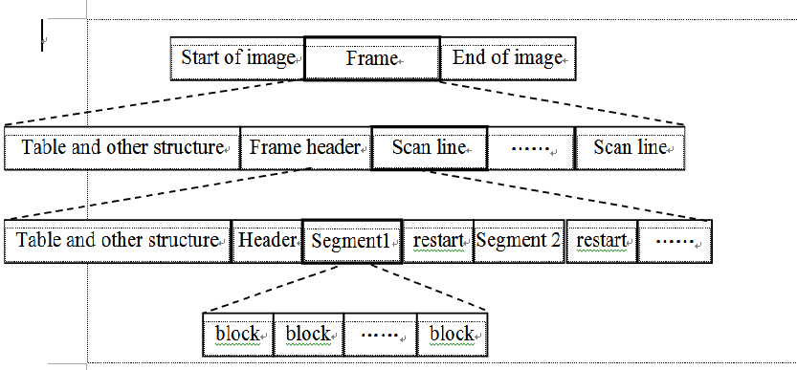
JPEG file structure

Slide 20
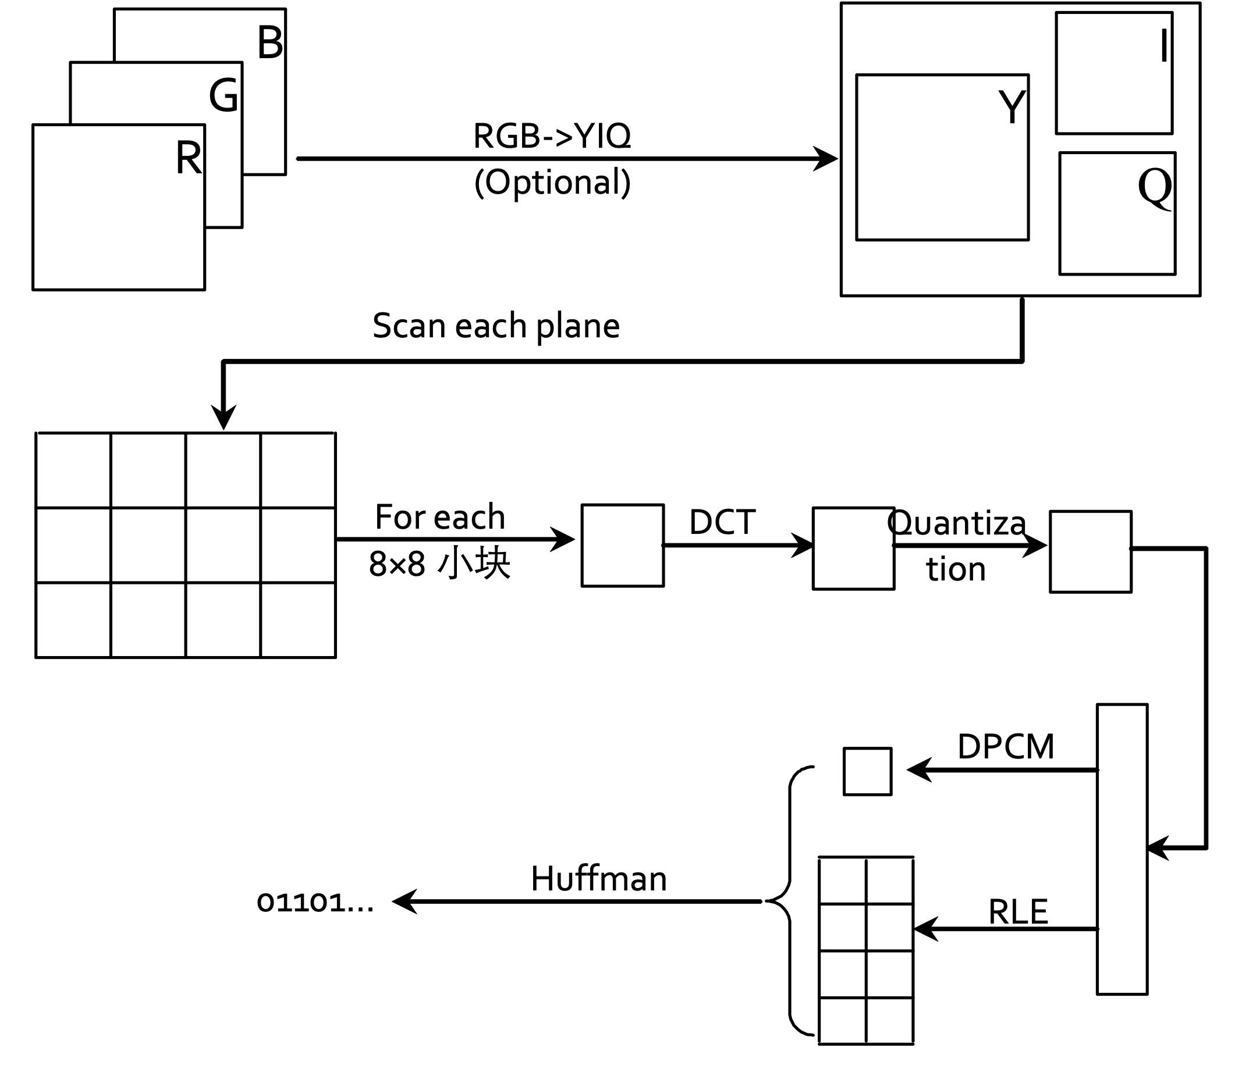
JPEG encoding principle
DPCM encoding, (differential pulse-code modulation, DPCM) is a modulation technique invented by the British Alec Reeves in 1937. It is a digital representation of an analog signal where the magnitude of the signal is sampled regularly at uniform intervals.
Notes:
DPCM编码, differential pulse-code modulation，是对模拟信号幅度抽样的差值进行量化编码的调制方式。这种方式是用已经过去的抽样值来预测当前的抽样值，对它们的差值进行编码。差值编码可以提高编码频率，这种技术已应用于模拟信号的数字通信之中。

Slide 21
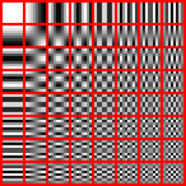
JPEG uses DCT
Note: JPEG is NOT JPEG2000
The DCT transforms an 8×8 block of input values to a linear combination of these 64 patterns. The patterns are referred to as the two-dimensional DCT basis functions, and the output values are referred to as transform coefficients.

Slide 22
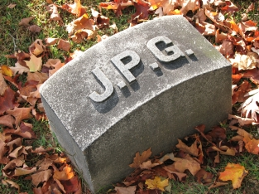

Quality: Higher quality (Q = 100)
Size: 83,261 bytes
Compression rate: 2.6:1
Quality: Higher quality (Q = 50)
Size: 15,138 bytes
Compression rate: 15:1

Slide 23


Quality: Higher quality (Q = 25)
Size: 9,553 bytes
Compression rate: 23:1
Quality: Higher quality (Q = 10)
Size: 4,787 bytes
Compression rate: 46:1

Slide 24
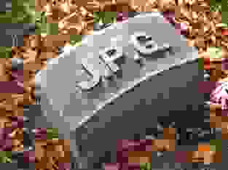
Quality: Higher quality (Q = 5)
Size: 2,396 bytes
Compression rate: 100:1

Slide 25




JPEG’s disadvantages
Not for line drawing, text, symbol, icon, etc..
Its lossy compression leads to unavoidable artifacts.
Notes:
不适合用于线条画、文字、图标等，其有损压缩会导致这类对象的瑕疵严重

Slide 26


JPEG
JPEG

Slide 27
TIFF format
TIFF (Tagged Image File Format): an extensively used raster image format for:
scanner
CAD system
GIS (Geographic Information System)
…
Filename extension | .tiff, .tif
Type code | TIFF
Uniform Type Identifier | public.tiff
Developed by | Aldus, now Adobe Systems
Initial release | 1986
Type of format | Image file format
Extended to | Exif, DCF, TIFF/EP, TIFF/IT, TIFF-FX, GeoTIFF
Notes:
TIFF是Tagged Image File Format的缩写，是一个广为应用的光栅图像文件格式，它的来源有：
扫描仪
CAD系统
地理信息
…
1986年发表最早的版本V1、V2
1989年发表版本V5.0
1992年，V6.0
TIFF是一个非常稳定的文件格式，有很长的应用历史
有公共的软件库来读写TIFF格式的图像（支持各种操作系统）

Slide 28
TIFF characteristics
Universal: Support devices from high-end to low end
Highly extendable: support public tag and private tag
Flexible: Support several compression formats
Accessible: public software library available
Powerful
Binary image
Grayscale image
Palette
True color
Other extension.
Notes:
支持从高端到低端的设备
可扩展性强，支持公共和私用的标记结构
支持各种压缩格式
有公共软件库支持
二值图
灰度图
调色板
真彩色
其他扩展

Slide 29
TIFF file structure
struct TIFF_img {
unsigned char **mono;
unsigned char **cmap;
unsigned char ***color;
char TIFF_type;
char compress_type;
int height;
int width;
};

Slide 30
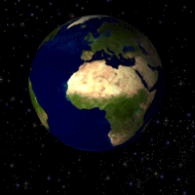

GIF examples

Slide 31
GIF file format
Graphics Interchange Format
LZW encoding method is employed.
One GIF stores several image frames.
Has color table (global (all frames) or local color table)
Support display order custom or lay over.
Allow interlacing store
Support text embedding
Notes:
采用复杂的LZW编码方式
一个GIF文件可以存储多幅图像
带有色彩表（全局、局部色彩表）
支持图像定序显示或覆盖
可以错行存放
支持文本覆盖

Slide 32

GIF file structure

Slide 33
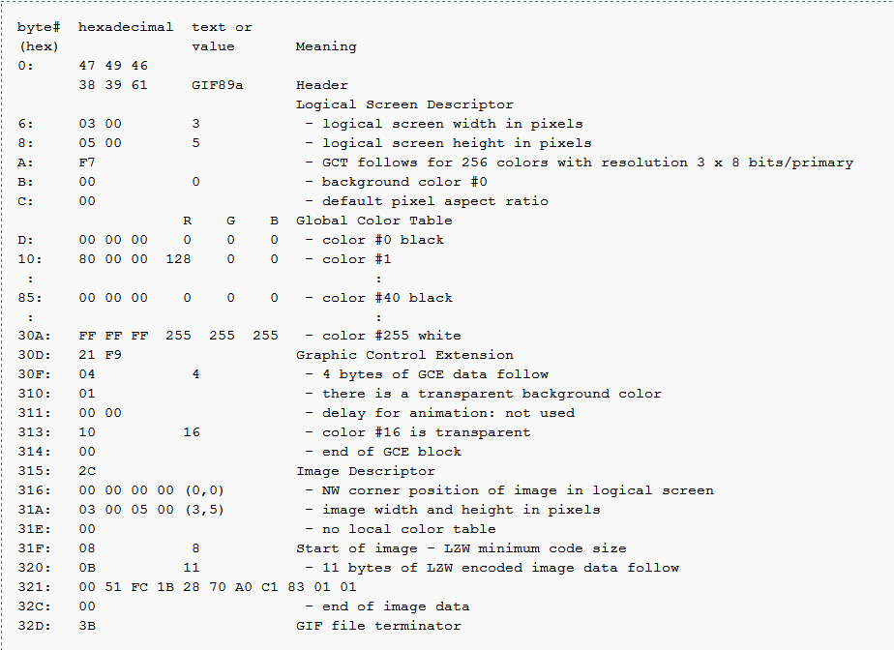

Slide 34
Image processing data structure
Matrices
Chains
Topological Data Structures
Rational Structures
Note
Matrices to rational structures is a kind of relationship from low level to high level, i.e., from semantic independent to semantic dependent.
Notes:
(矩阵式)
(链式)
(拓扑数据结构)
(有理数据结构/合理数据结构)
Matrix 到有理数据结构是一个由底层到高层的关系，由没有语义到有语义。

Slide 35
Matrices
Matrix is the most common data structure for low-level representation of an image
Elements of the matrix: gray level, brightness, or other properties
Access via coordinates of pixel location
Binary images: represented by a matrix containing only zeros and ones

Slide 36
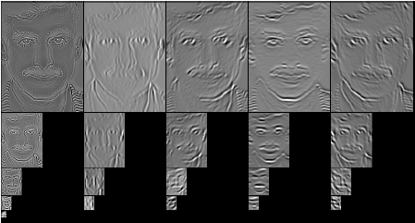
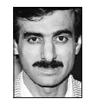
Matrices of different resolution
Multispectral image represented by several matrices: each matrix containing an image corresponding to one spectral band
Original face image

Slide 37
Chains
Chain codes: Chains are used for description of object borders
Chains can be represented using static data structures (e.g., 1D arrays); their size is the longest length of the chain expected.

Slide 38
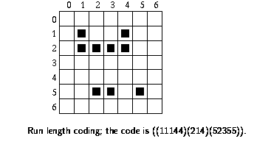
Chains: Run length encoding (RLE)
In binary images, run length coding records only areas that belong to the object in the image; the area is then represented as a list of lists.
Each row of the image is described by a sublist, the first element of which is the row number.
Subsequent terms are coordinate pairs; the first element of a pair is the beginning of a run and the second is the end.
There can be several such sequences in the row.

Slide 39
Image processing programming
Windows APIs for accessing DIB
VC++ programming and example
Matlab image processing toolbox

Slide 40
Windows APIs for accessing DIB
LoadImage
HANDLE LoadImage(HINSTANCE hinst,
LPCTSTR lpszName,
UINT uType,
int cxDesired,
int cyDesired,
UINT fuLoad
);
Display DIB
BitBlt
SetDIBitsToDevice
StretchDIBits
#include <windows.h>

Slide 41
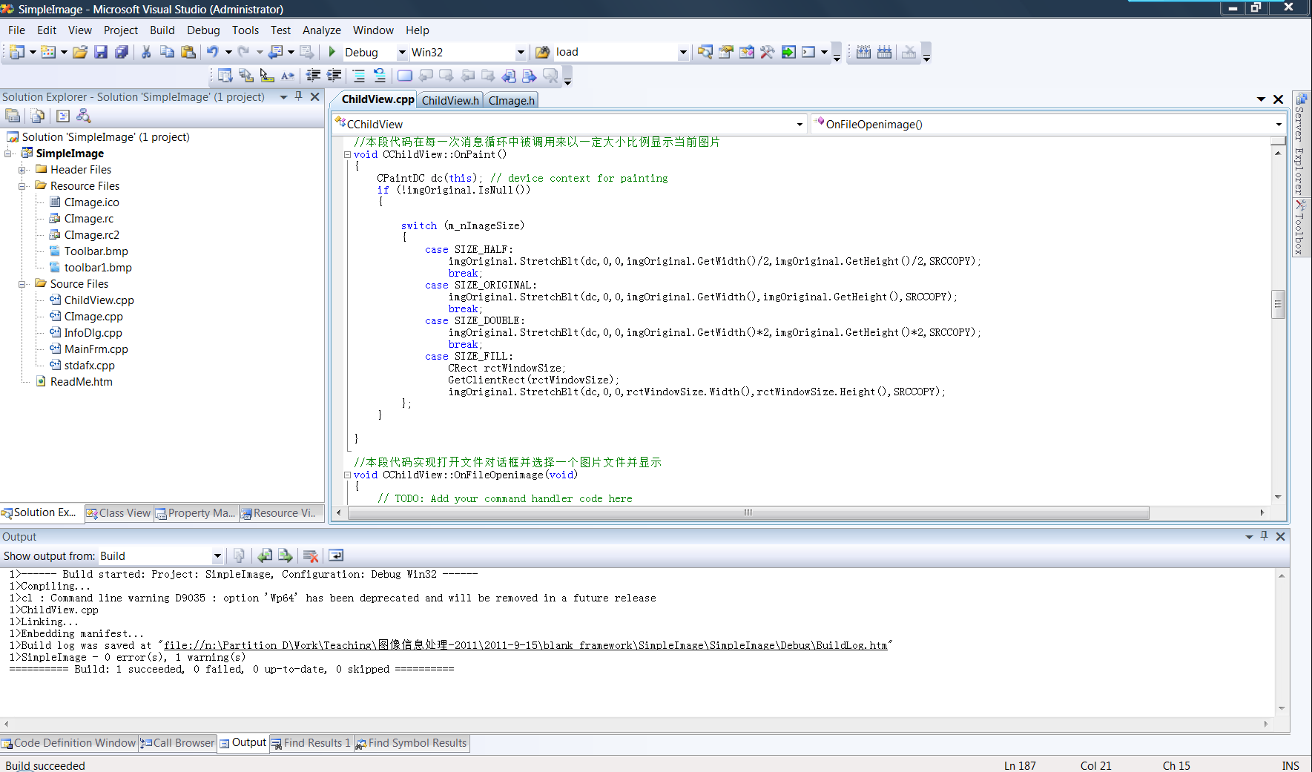
VC++ programming and example

Slide 42
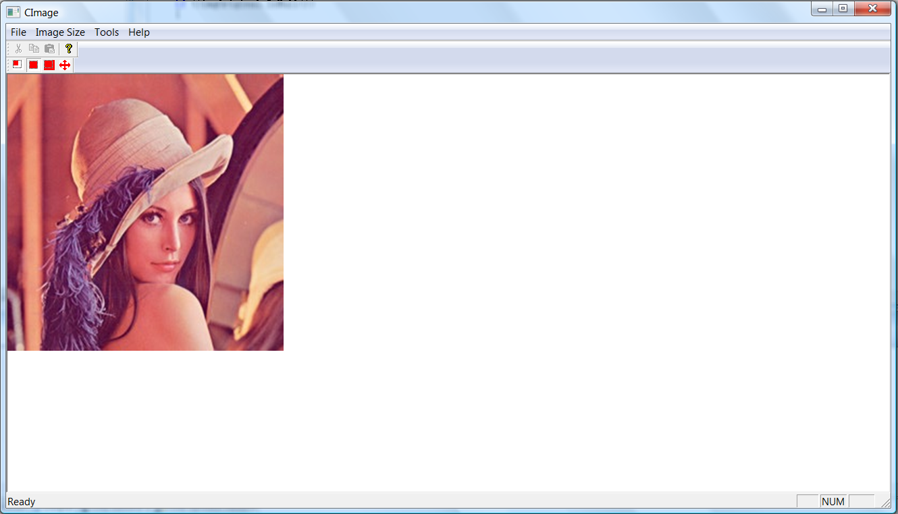
VC++ programming and example

Slide 43
Matlab image processing toolbox
MATLAB and Image Processing Toolbox provide lots of image processing functions.
Users can use these functions to analyze the image data, acquire image details and design suitable filters.
With the designed filters, you can perform de-noise, enhancement, etc..
OR you can design a comprehensive filter by using Simulink: just drag-and-drop is needed.
Notes:
MATLAB 和 Image Processing Toolbox 提供了大量的用于图像处理的函数，用户可以利用这些函数分析图像数据，获取图像细节信息，并且设计相应的滤波算法。
利用设计的滤波算法可以将图像数据所包含的噪声滤除，而滤波器的设计师通过 MATLAB 产品提供的交互式工具完成的，这些工具还能够完成选区图像区域，测量图像误差和获取、统计像素信息等功能。

Slide 44
Matlab image processing functions
Imread
Imwrite
Imshow
I = imread('pout.tif');
imshow(I)
I2 = histeq(I);
Imshow(I2)

Slide 45
Image Processing Toolbox
Image display and exploration
GUI Tools
Spatial Transformation and Image Registration
Image Analysis and Statistics
Image Arithmetic
Image Enhancement and Restoration
Linear Filtering and Transforms
Morphological Operations
ROI-based, Neighborhood, and Block Processing
Colormaps and Color Space
Utilities: array operation, demos, preferences and others

Slide 46
Adobe Photoshop
Function:professional software for image processing
Image eidting
Filters
Tools: region selection, brush, …
Image layer
Color manipulation
Color depth adjustment
Luminance, contrast adjustment
Drawing and output
…
Notes:
功能：是专门用来进行图像处理的软件。
对图形进行修饰和编辑
滤镜(filters)
各种工具(区域选择工具、各种笔刷…)
多层(layer)
以及对图像的色彩处理;
颜色深度调节
亮度、对比度等条件
另外，还有绘图和输出功能等。

Slide 47
GIMP
Function：Professional open source image processing software under Linux and Windows
Image editing
Filters
Tools: region selection, brush
Image layer
Color manipulation
Color depth adjustment
Luminance, contrast adjustment
Drawing and output
Notes:
Linux下用来进行图像处理的软件。
对图形进行修饰和编辑
滤镜(filters)
各种工具(区域选择工具、各种笔刷…)
多层(layer)
以及对图像的色彩处理;
颜色深度调节
亮度、对比度等条件
另外，还有绘图和输出功能等。

Slide 48
Acdsee
ACDSee is a professional image browsing and lightweight image editing software
Support almost all kinds of image formats
Plugin supported
Video browsing supported

Slide 49
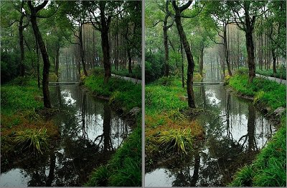
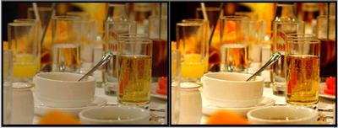
Shadow magic hands (光影魔术手)
A photo quality enhancement and personalization software.
Easy, simple and free to use

